Slide 1

Analysis on Motor Vehicle Collisions

Slide 2
Team Introduction
Group Number : 06
Section Number : 004
Team Members:
Deepak Mathaiah Pattem
Joel Soloman Raj Addala
Jerusha Sheba Maben
Manushree Venkatesh
Ram Sundar Thanumalaya Perumal

Slide 3
Background / motivation
New York City is the most populated city in the United States of America. As a result, it is not surprising that there is a lot of traffic in the city, which increases the likelihood of accidents.
Statistical research conducted by analysts at Jay S. Knispel revealed that there were over 88k accidents in 2020 alone. Considering that the epidemic kept most of the year behind lock and key, that is a lot. Since then, the world has mostly recovered from the epidemic; thus, the traffic problem is only going to become worse.
By understanding and analyzing the contributors to these accidents in NYC, it is possible to raise public health and safety and reduce the occurrence of accidents in other cities in similar situations.

Slide 4
Problem statement
Car accidents are a major concern regarding the safety of the population in densely populated cities. In most cases despite the government's efforts to improve road safety, car crashes continue to occur every year. This project is set to analyze an NYPD data set recording car accidents in New York cities to understand the contributing factors and aid in developing strategies for the prevention of such accidents.

Slide 5
Project Proposal
Our team intends to identify patterns using descriptive analysis, to gain a better understanding of how, why, and when these accidents occur. With those parameters, we aim to find leading causes. This will help provide clarity on which contributors to focus on to reduce car crashes dramatically.

Slide 6
Analysis Questions
Which are the largest contributors to car crashes in NYC?
Which areas are the most prone to car crashes?
What is the relation between the time and frequency of car crashes?

Slide 7
Data set description
This data set is the collection of all the motor vehicle collisions recorded by the NYPD, available on the data.gov site.
This data set contains incidents from 2016 till 2022
In total there are 3,704,406 records and 25 variables in the data set.
The Records are subset to make the data manageable for this analysis. For this we take into consideration the incidents that occurred from 2019 till 2021.
This makes the effective shape of the dataset to be 442,109 records and 25 variables.

Slide 8
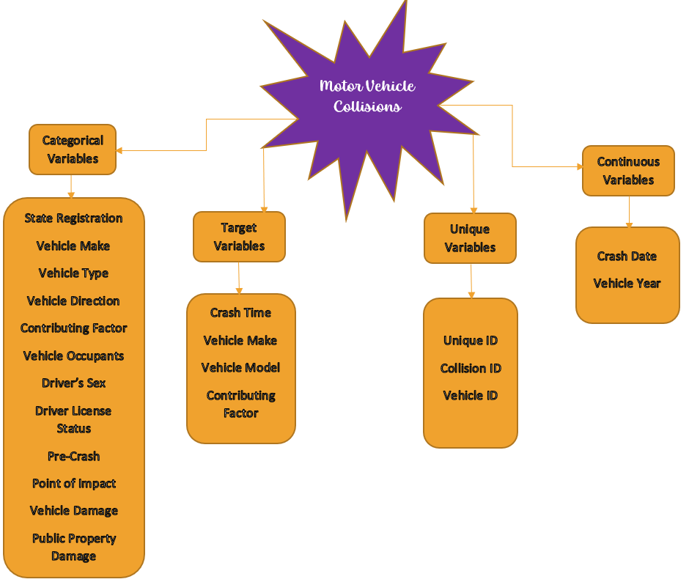
Data set description

Slide 9
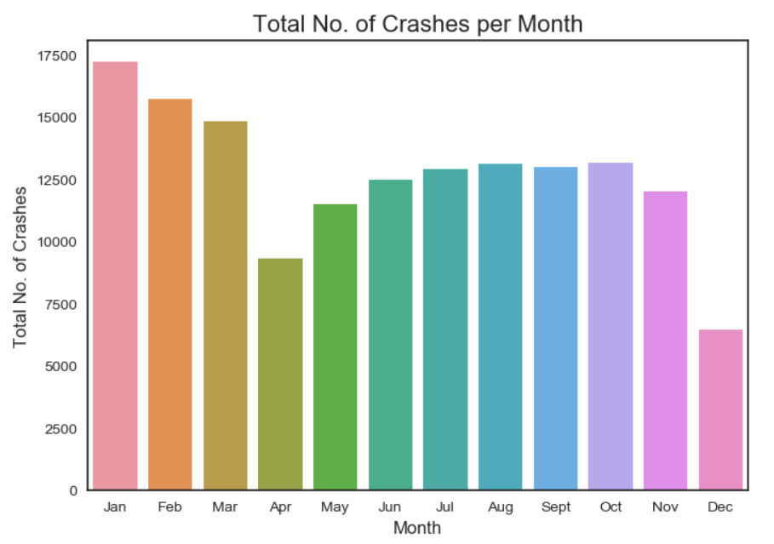
Sample Visualisation

Slide 10
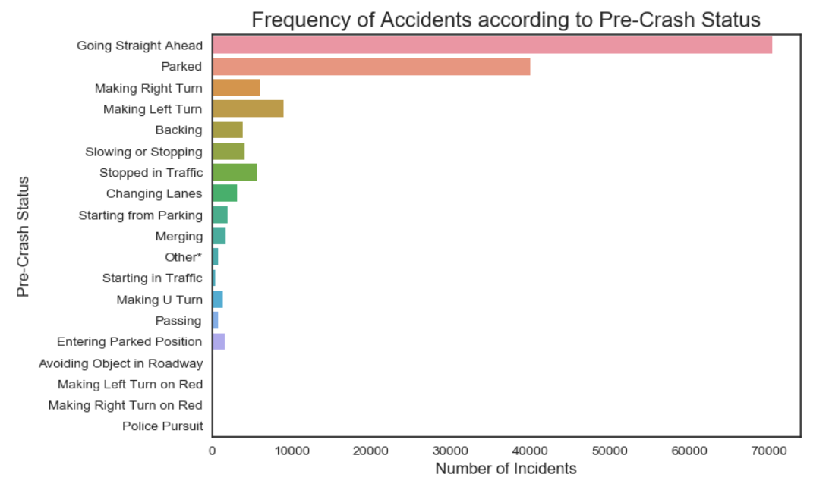
Sample Visualisation

Slide 11
References
New York City Car Accident Statistics - November 2022 Update - Law Offices of Jay S. Knispel Personal Injury Lawyers (jknylaw.com)

